Slide 1
Chapter 1 Object-Oriented System Development

Slide 2
Chapter 1 Topics
Characteristics of OO development
OO concepts: object, class, instance, attributes, methods, and encapsulation
Object interaction through methods and association relationships
The concept of inheritance applied to classes of objects
Benefits of using OO development
Preview of OO development

Slide 3
Object-Oriented System Development
OO information system development involves:
OOA
Using an OO approach to system analysis
OOD
Using an OO approach to system design
OOP
Using an OO approach to programming

Slide 4
Understanding OO Development
OO approach
System is defined as a collection of objects that work together to accomplish tasks
Objects carry out actions when asked
Each object maintains its own data
Procedural approach
System is defined as a set of procedures that interact with data
Data is maintained separately from procedures

Slide 5
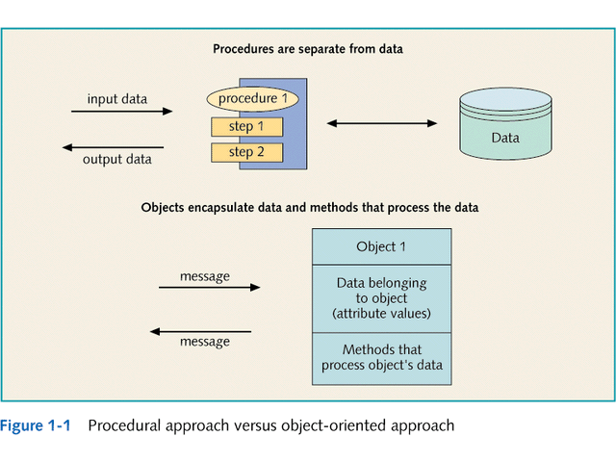

Slide 6
Understanding OO Development
OO Programming (OOP)
Started in 1960s in Norway
Simula
First language designed to run computer simulations
Simulations involve objects that maintain their own data values and can interact independently
1970s at Xerox PARC
Smalltalk
First general purpose OO programming language

Slide 7
Understanding OO Development
OO Programming (OOP)
Java
Introduced in 1995 by Sun Microsystems
“pure” OO language
Syntax similar to C++
Cross platform
Ideal for Web-based applications

Slide 8
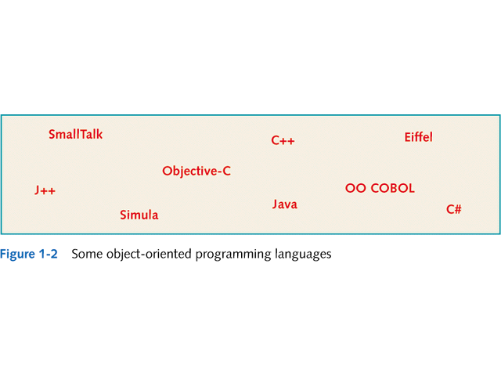

Slide 9
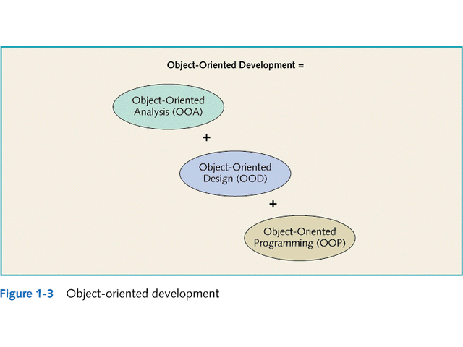

Slide 10
Understanding OO Development
OO Analysis and Design
Unified Modeling Language (UML)
Standard OOA&D modeling notation
Defined by: Grady Booch, James Rumbaugh & Ivar Jacobson
Uses model-driven approach:
Enables creation of graphical models of the system requirements and system design

Slide 11
Understanding OO Development
OO Analysis and Design
Unified Modeling Language (UML)
Components
Class diagrams
Use Case diagrams
Sequence diagrams
Statecharts

Slide 12
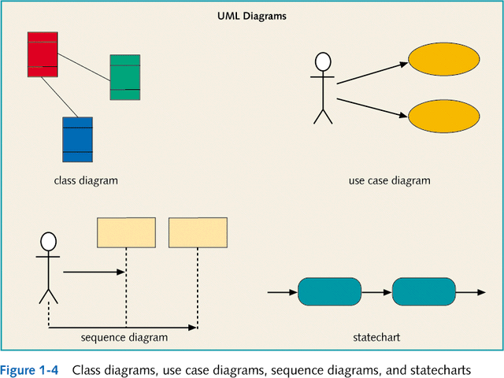

Slide 13
Understanding OO Development
OO Analysis and Design
System Development Life Cycle (SDLC)
Project management framework that defines project phases and activities
Phases:
Planning
Analysis
Design
Implementation
Support

Slide 14
Understanding OO Development
OO Analysis and Design
Prototyping
Creating a working model of one or more parts of the system for user evaluation and feedback
Joint Application Development (JAD)
Key system stakeholders and decision makers work together to rapidly define system requirements and designs

Slide 15
Understanding OO Development
OO Analysis and Design
Other requirements:
Project management
Interviewing
Data collection
User interface (UI) design
Testing
Conversion techniques

Slide 16
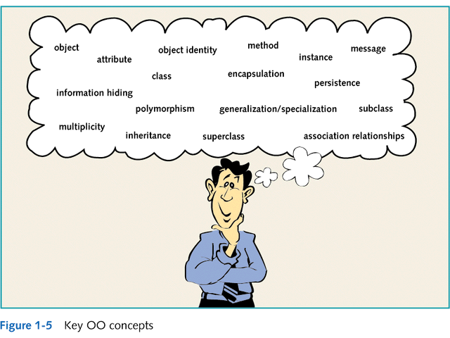

Slide 17
Understanding OO Concepts
Objects, Attributes, and Methods
Object:
Attributes
Characteristics of an object that have values
Behaviors (or methods)
Describe what an object can do
Examples:
GUI objects
Problem Domain objects

Slide 18
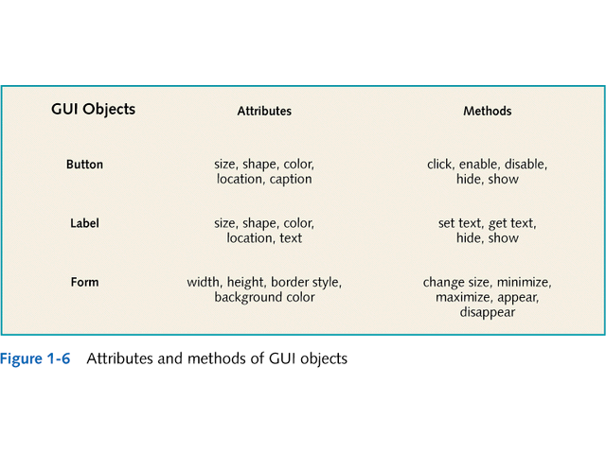

Slide 19
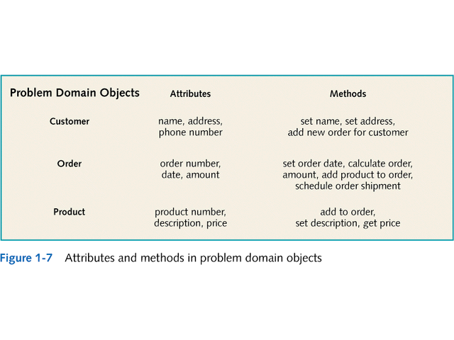

Slide 20
Understanding OO Concepts
Object Interactions and Messages
Messages
The means by which objects interact
Example:
User initiates interaction via messages to GUI objects
GUI objects interact with problem domain objects via messages
Problem domain objects interact with each other and GUI objects via messages
GUI objects respond to user via messages

Slide 21
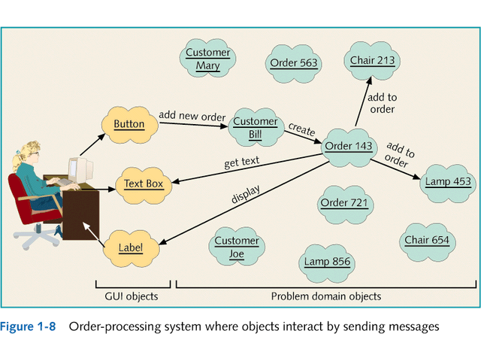

Slide 22
Understanding OO Concepts
Encapsulation and Information Hiding
Encapsulation
Objects have attributes and methods combined into one unit
Information Hiding
Hiding the internal structure of objects, protecting them from corruption

Slide 23
Understanding OO Concepts
Encapsulation and Information Hiding
Identity
Unique reference for each object
Persistent objects
Defined as available for use over time

Slide 24
Understanding OO Concepts
Classes, Instances, and Associations
Class
Defines what all objects of the class represent
Instances
Objects of the class

Slide 25
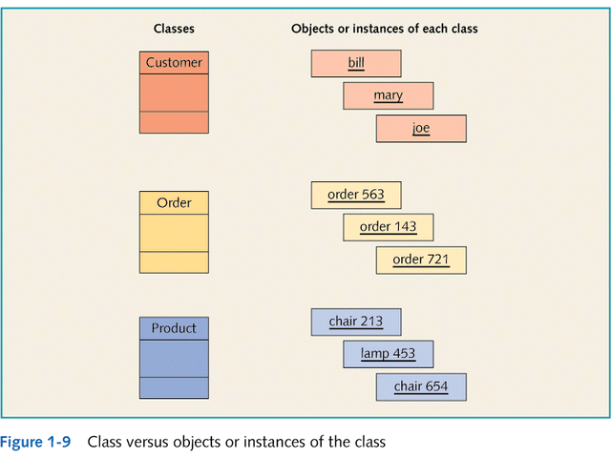

Slide 26
Understanding OO Concepts
Classes, Instances, and Associations
Association relationships
Each object is responsible for maintaining relationships with other objects
One-to-one
One-to-many
Multiplicity of the association
Number of associations in UML terminology
Cardinality of the association
Number of associations in ERD terminology

Slide 27
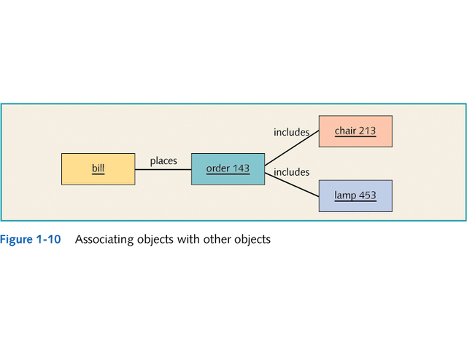

Slide 28
Understanding OO Concepts
Inheritance and Polymorphism
Inheritance
One class of objects takes on characteristics of another class and extends them
Superclass → subclass
Generalization/specialization hierarchy
Also called an inheritance hierarchy
Result of extending class into more specific subclasses

Slide 29
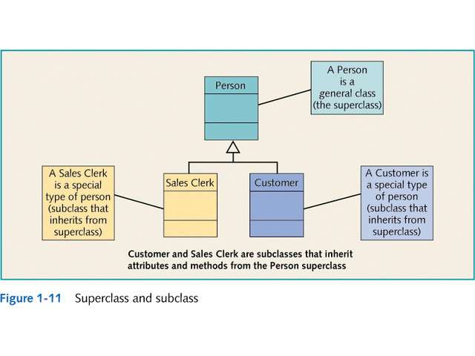

Slide 30
Understanding OO Concepts
Inheritance and Polymorphism
Polymorphism
“many forms”
Different objects can respond in their own way to the same message

Slide 31
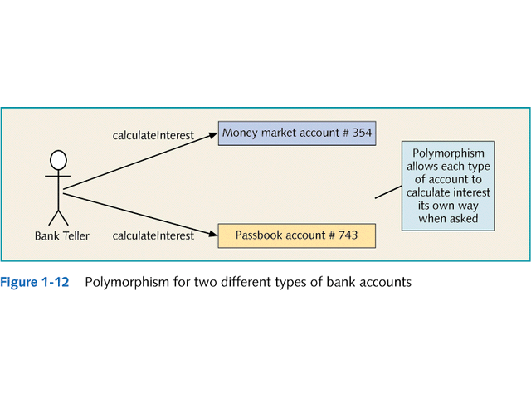

Slide 32
Recognizing the Benefits of OO Development
Objects are More Natural
Naturalness
Based on the fact that people usually think about their world in terms of objects
Natural to define the classes of objects involved
OO vs. procedural
Which is harder to learn?

Slide 33
Recognizing the Benefits of OO Development
Classes of Objects can be Reused
Reuse
Classes and objects can be invented once and used many times
During analysis, design, and programming
Do not need source code for reused class, simply need to know interface

Slide 34
Learning OO Development
Introducing Three-Tier Design
Objects that interact in OO system are separated into three categories of classes:
Problem domain classes
Specific to a particular business application
GUI classes
Define objects that make up the UI to the application
Data access classes
Work with DBMS to store/retrieve object information

Slide 35
Learning OO Development
Part 1: OO Concepts and Java
Covers OO concepts and introduces Java
Chapter 1
OO development, concepts and benefits
Chapter 2
Java fundamentals
Chapter 3
Java classes
Chapter 4
OOA & OOD concepts / Bradshaw Marina (case study)

Slide 36
Learning OO Development
Part 2: Defining Problem Domain Classes
Using Java to create new problem domain classes
Chapter 5
How to create a problem domain class
Chapter 6
Data validation, exception handling, and method overloading
Chapter 7/8
Generalization/specialization and inheritance
Chapter 9
Implementing association relationships

Slide 37
Learning OO Development
Part 3: Defining GUI Classes
Creating graphical user interfaces
Chapter 10
Java event model
Chapter 11
GUI windows for problem domain object interaction
Chapter 12
Main menu and multiple GUI windows
Chapter 13
Using an IDE

Slide 38
Learning OO Development
Part 4: Defining Data Access Classes
Creating data access objects for managing database interactions and achieving object persistence
Chapter 14
Achieving object persistence
Chapter 15
RDBMS and SQL

Slide 39
Learning OO Development
Part 5: Deploying the Three-Tier Application
Bringing it all together in a complete client-server system
Chapter 16
Complete OO development process for case study
Chapter 17
Deploying the web-based case study using HTML and Java servlets

